Slide 1

Day 2: AI-ML Session
Kushal Trivedi
Murtuza Shaikh

Slide 2

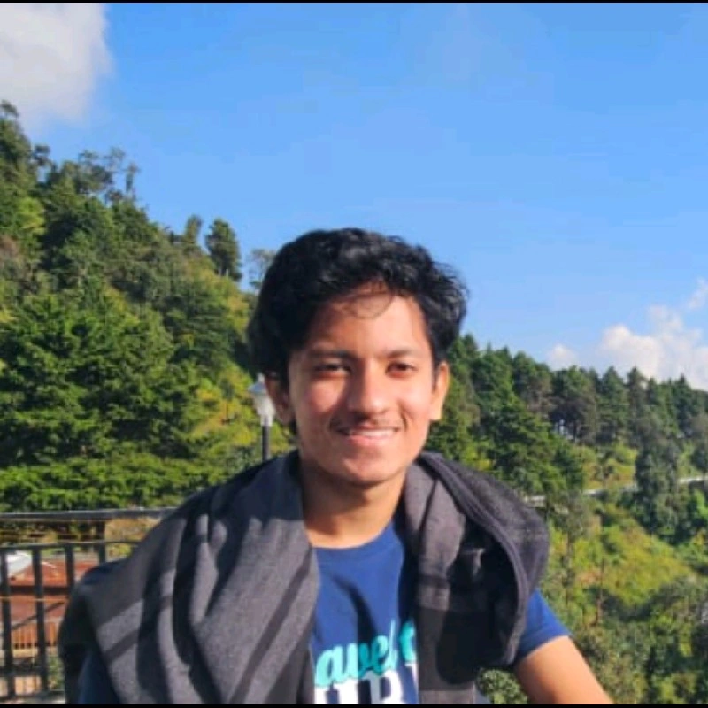
A little bit ‘bout ourselves…
Ex - SRF @ IIT KGP
Ex - RI @ Makdesign
Broadly interested in everything about AI and Computers
Music, music, music
Upcoming Intern @Fibe
SIH 24’ Winner
Curious at the intersection of mathematics, physics and CS
See me play football everyday!
Fun Fact: We have been friends since the 5th, i.e. 2015, ~11 years!

Slide 3
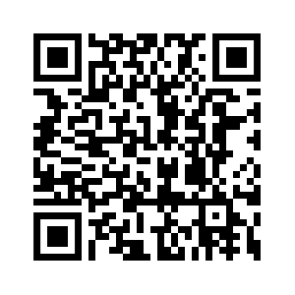
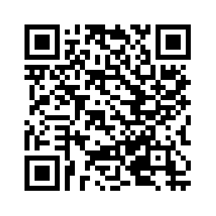
Shameless promotion…
Kushal
Murtuza

Slide 4
“AI is Magic, but that Magic is Math” ~A quote one night before the session ☺

Slide 5
Our topic of discussion today?
A general discussion
(i. What is AI? & ii. A Roadmap to begin & iii. Mistakes to avoid)
“The first topic” of AI => Linear Regression
Our favorite topic => Style Transfer/ Image Generation/ Video Generation

Slide 6
Roadmap to Learning AI (Our take…)
A basic-to-good grasp on Math (especially for research) [~10-15 days]
1st year courses would do (Linear Algebra/ Calculus/ Probability/ Statistics)
Learn Python (please!) [You could spend a month]
Start with NumPy/ Pandas/ Matplotlib/ Scikit Learn/ Seaborn (optionally)
Start with Machine Learning or Data Science [~1 month]
*Only if you are interested*, go ahead with Deep Learning [~1-2 months]
Pick a niche: Computer Vision/ Natural Language Processing/ Robotics etc. [No timeline]
Find your own path!

Slide 7
Roadmap to Learning AI (Extd.) Which Channels to Follow?!
Andrew Ng (Stanford lecs/ Coursera lecs)
Krish Naik
StatQuest
Codebasics (Python Libraries)
CampusX
Nicholas Renotte
Andrej Karpathy (One of the ex-founding engineers @ Tesla, OpenAI)
MIT/ Stanford or any other top colleges’ AI playlists
Books, books, books! (My favorite publication: O’Reilly)

Slide 8
Mistakes I Did, and The Best Things I Did
The general way of learning: theory (please understand the math) => code => proceed [Do not just focus on either, avoiding the other one]
It is overwhelming, be patient, do not rush with the concepts! This is CS + Natural Sciences.
Read papers! Even if you just focus on the engineering aspect, read the main ones.
Build good projects! Contribute to open source, contribute to research!
Showcase your work, keep failing. [Non-technical, but very imp.]

Slide 9
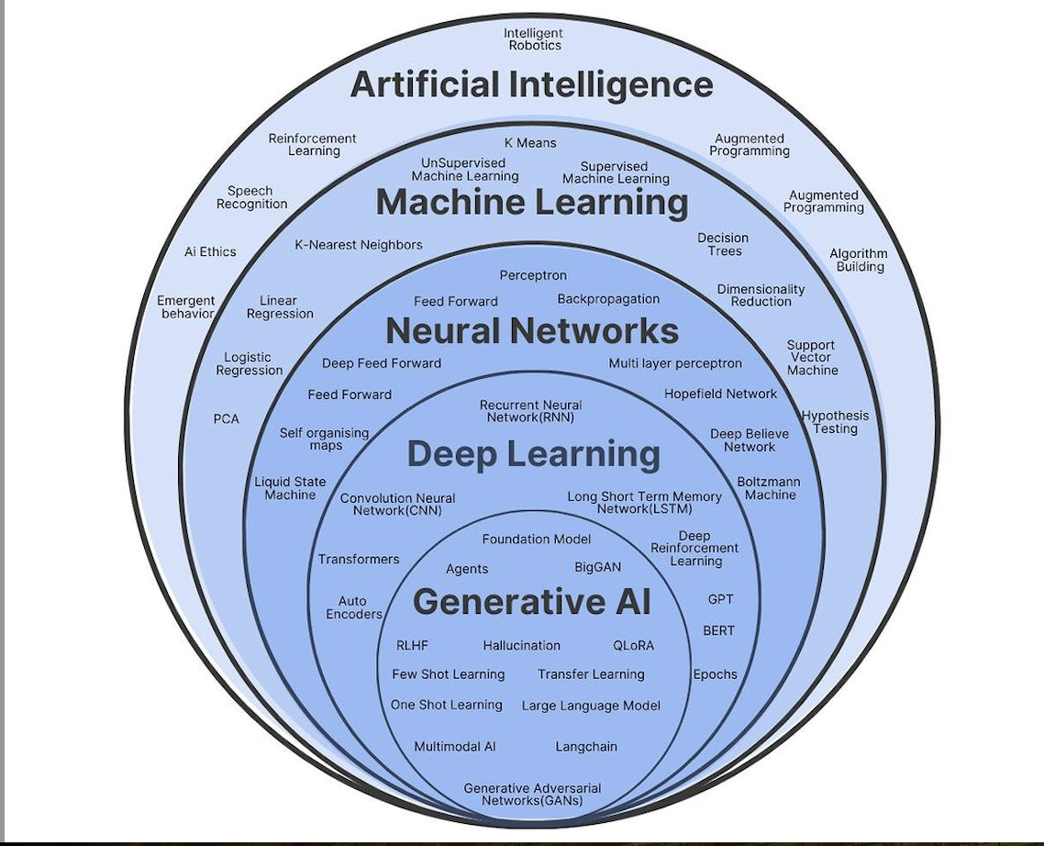
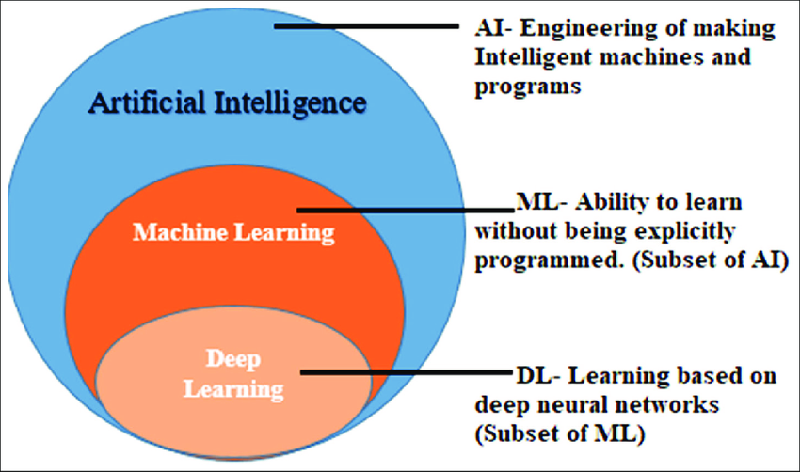
So, What is Artificial Intelligence/ Machine Learning/ Deep Learning?

Slide 10
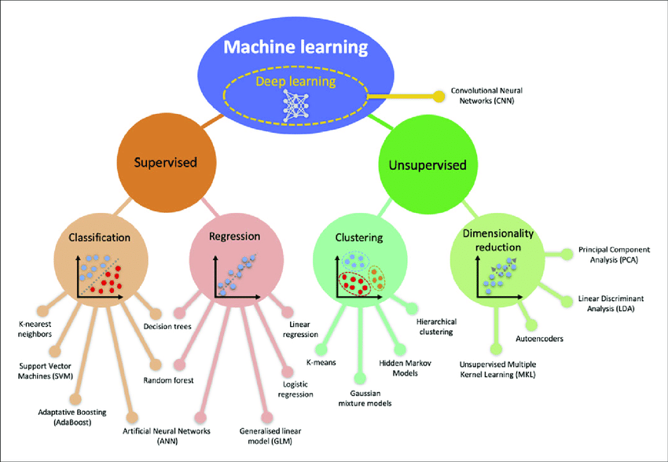
Machine Learning

Slide 11
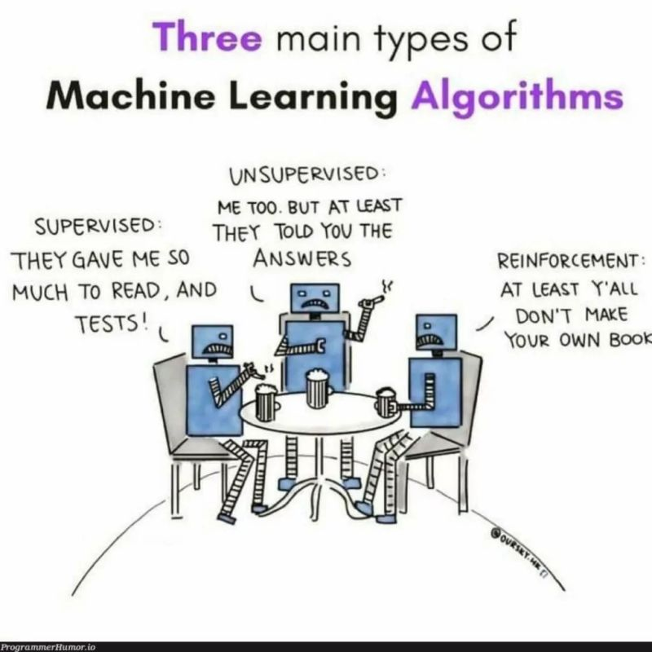
Meme.

Slide 12
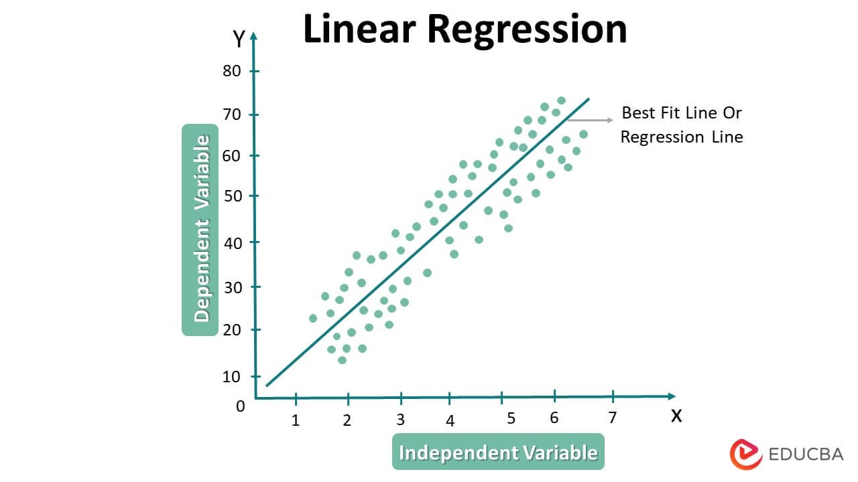
Giving a rough idea…
Regression is modelling the relationship between independent and dependent variables
If the relationship is linear or you require it to be linear, naturally it is called Linear Regression!

Slide 13
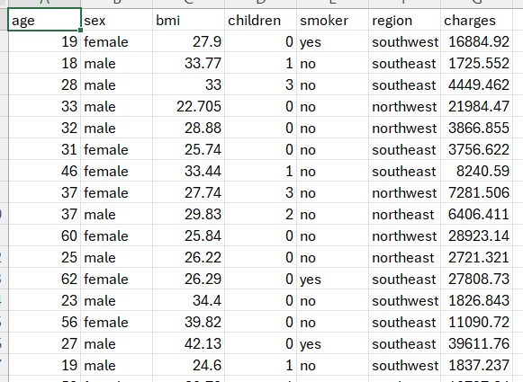
Example: Keep this in mind!
You want to predict insurance charges (target variable) when given the following set of inputs (feature variables):
Age
Sex
BMI
Children
Smoker
Region
(Note: All 6 are independent variables)

Slide 16

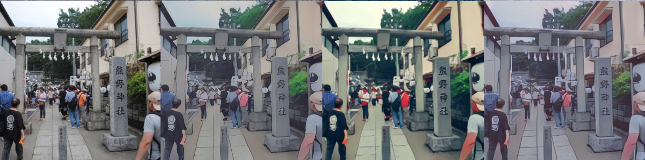
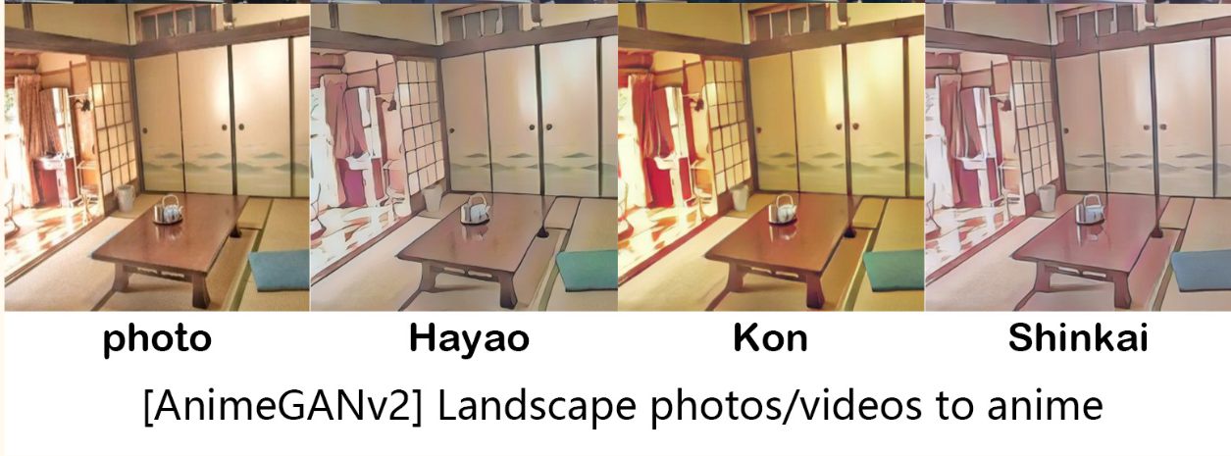
Anime Style Transfer
How does this work?!
https://huggingface.co/spaces/akhaliq/AnimeGANv2

Slide 17
A simple explanation
Neural Networks
Adversarial Game? (Arm wrestle!)
I want to beat you, you want to beat me, we have conflicting goals.
Game ends when one player loses.
i. Generator: Produce “fake” images which closely resemble the original image.
ii. Discriminator: Classify the Generator’s image as “fake” or “real”
Game ends when Generator wins, Discriminator loses.

Slide 18
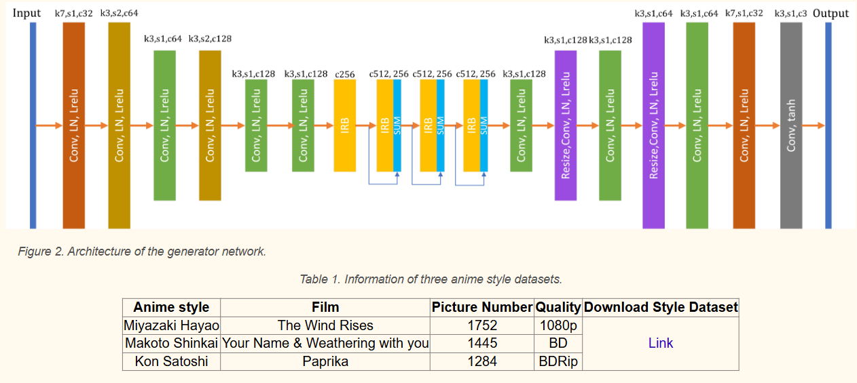
If you want to dig in more…
AnimeGANv2
https://www.bilibili.com/video/BV13T4y1773X/

Slide 19
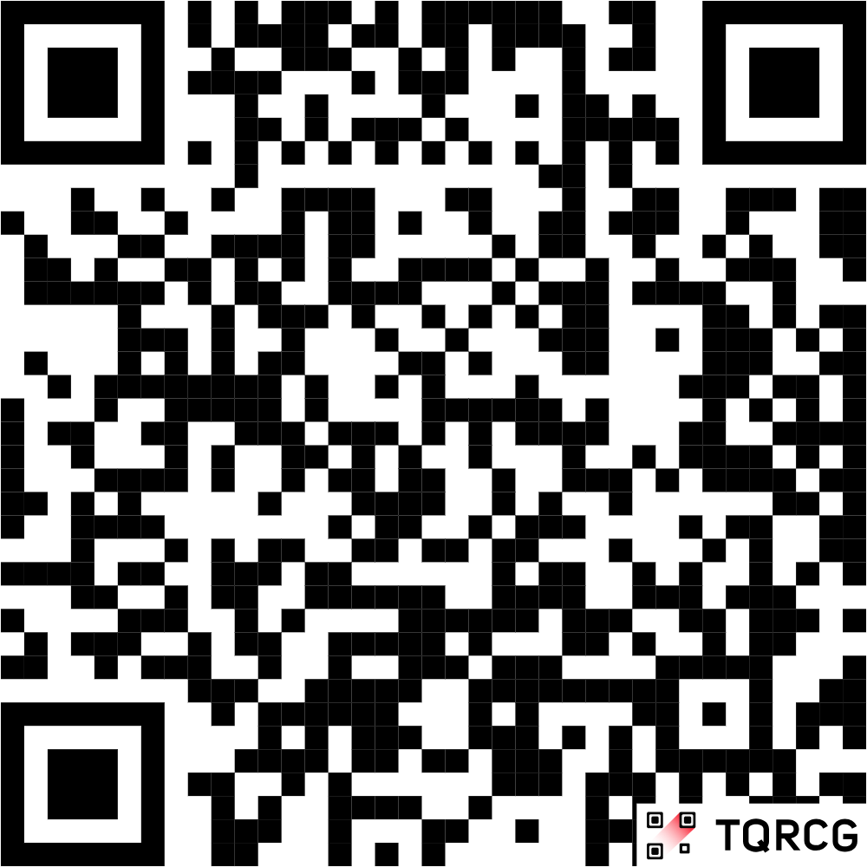
Feedback

Slide 20
Questions? Discussion? Please reach out! Thank you for attending!

